Slide 1
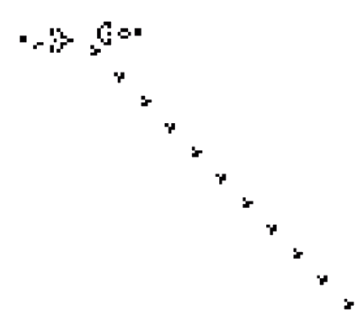
Game of Life
The cdm-8 project
made by Martynov B & Belov D
23217
Table of Contents
{01}
{04}
Introduction
Software
{02}
{05}
Problem Statement
User Guide
{03}
{06}
Hardware
Conclusion

Slide 2

{04}
{02}
{05}
{06}
Game of Life
The cdm-8 project
made by Martynov B & Belov D
23217
Table of Contents
{01}
Introduction
Software
Problem Statement
User Guide
{03}
Hardware
Conclusion

Slide 3
Rules
Neighbours are nearby cells (like a king in chess).
3 neighbours — cell can be born.
2 or 3 neighbours — cell continues to live.
Otherwise, the cell dies.
{01}
Introduction

Slide 4

Problem Statement
Standard rules
Neighbours are nearby cells (like a king in chess).
3 neighbours — cell can be born.
2 or 3 neighbours — cell continues to live.
Otherwise, the cell dies.
{02}
{01}
Introduction

Slide 5
{02}
Problem Statement
Subtasks
Rules
Neighbours are nearby cells (like a king in chess).
3 neighbours — cell can be born.
2 or 3 neighbours — cell continues to live.
Otherwise, the cell dies.
Divide the project into Logisim part and CdM8 part
Realise Logisim part
Realise CdM8 part
Step 1
Step 2
Step 3
Step 4
Step 5
Step 6
Connect both parts
Optimise it
Realise Check for bags
and fix it part

Slide 6
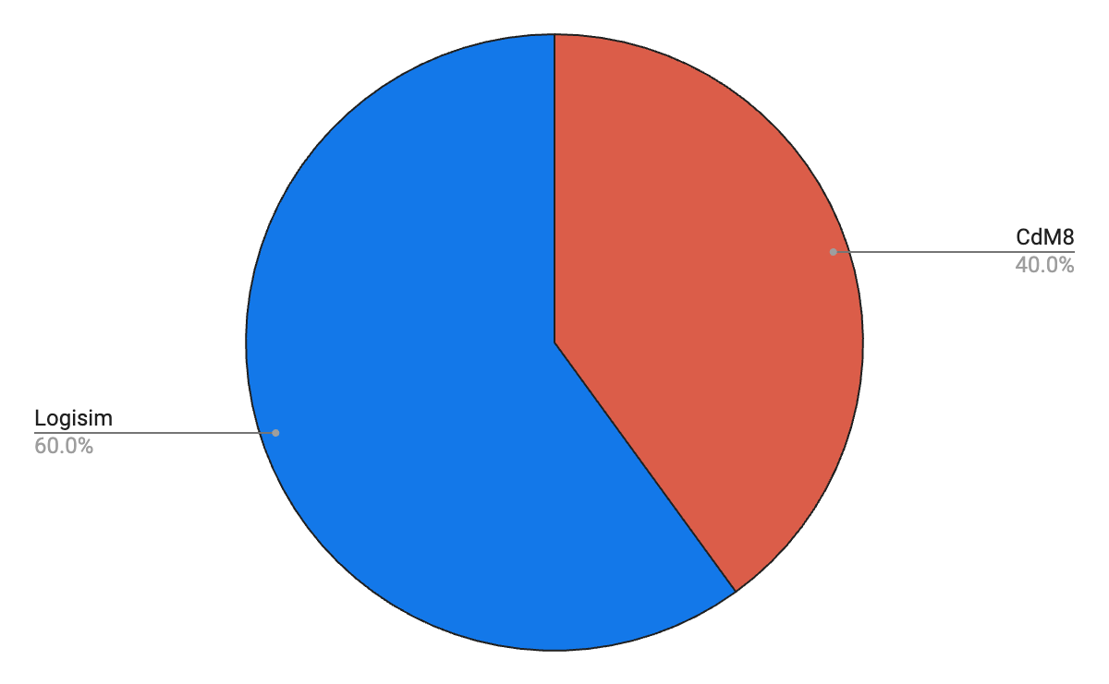
Subtasks
Logisim & CdM8
Divide the project into Logisim part and CdM8 part
Realise Logisim part
Realise CdM8 part
Step 1
Step 2
Step 3
{02}
Step 4
Step 5
Step 6
Problem Statement
Connect both parts
Optimise it
Realise Check for bugs
and fix it part
Logisim
Display
System of generation cells
Changing rules
Cdm8
Game Management – Keyboard

Slide 7
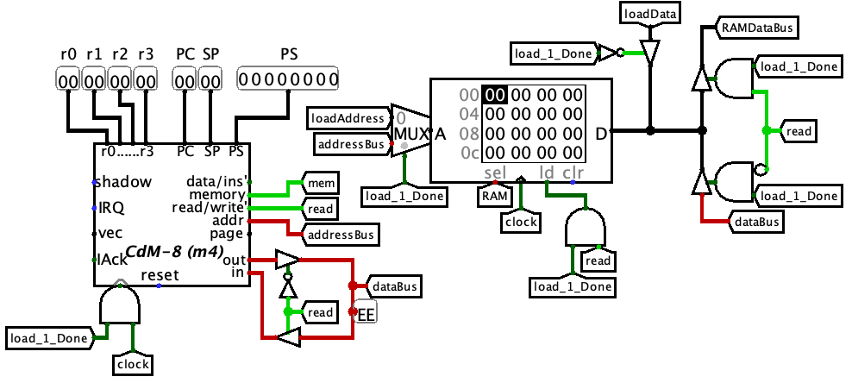

Logisim & CdM8
WWW
Logisim
Display
System of generation cells
Changing rules
Cdm8
{03}
Game Management – Keyboard
Hardware

Slide 8
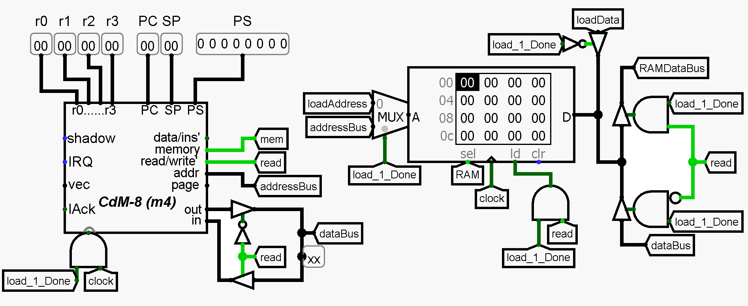
{03}
Hardware
Logisim & CdM8
WWW
Logisim
Display
System of generation cells
Changing rules
Cdm8
Game Management – Keyboard

Slide 9
Processor
CDM8+.circuit
{03}
Hardware

Slide 10
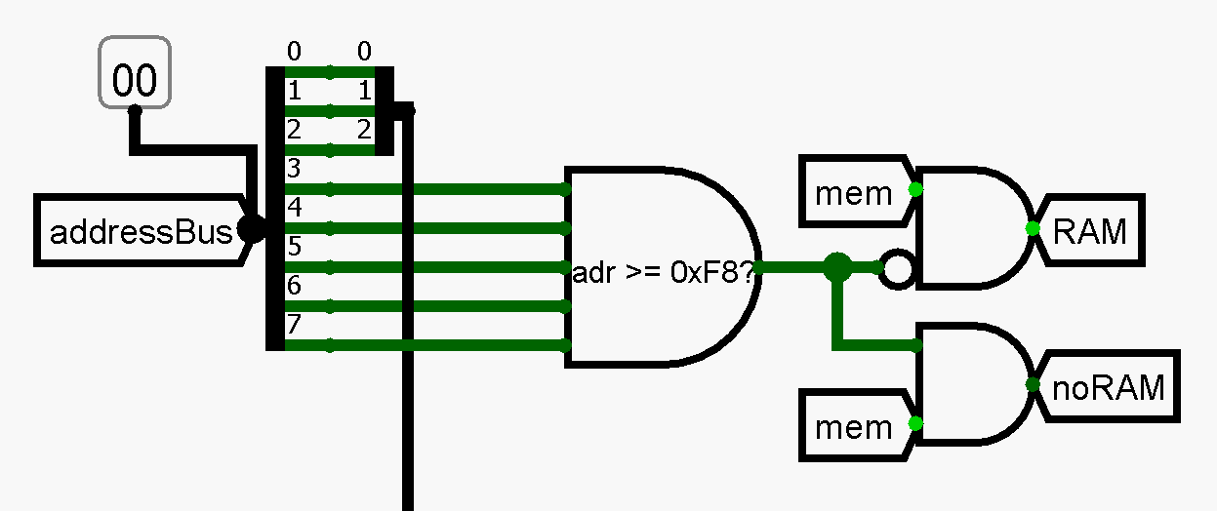
Read / Write RAM
CDM8+.circuit

Slide 11
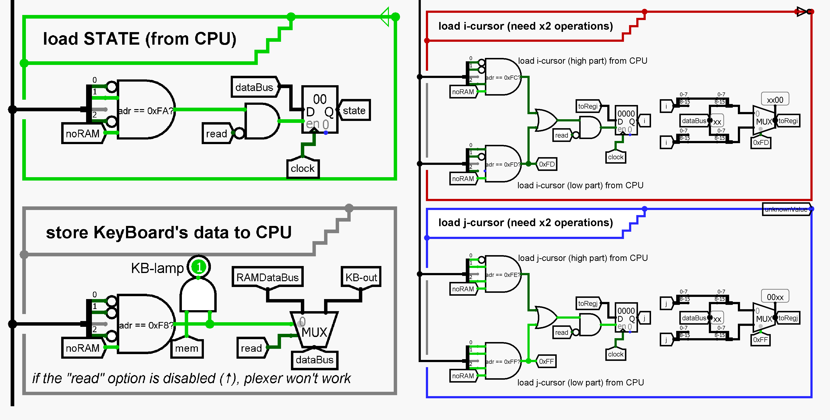
Read / Write RAM
CDM8+.circuit

Slide 12
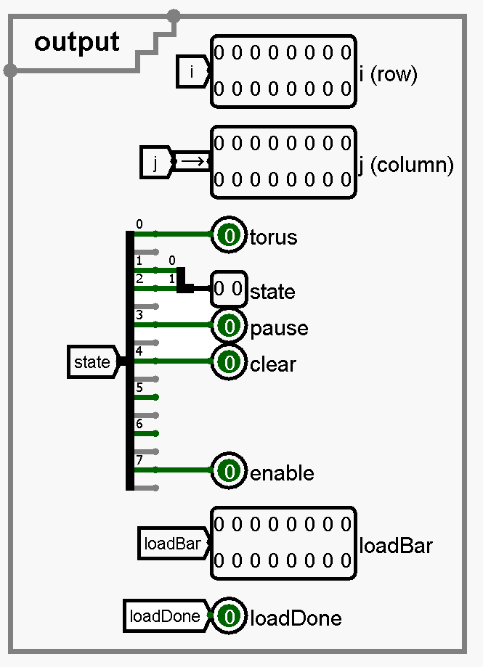
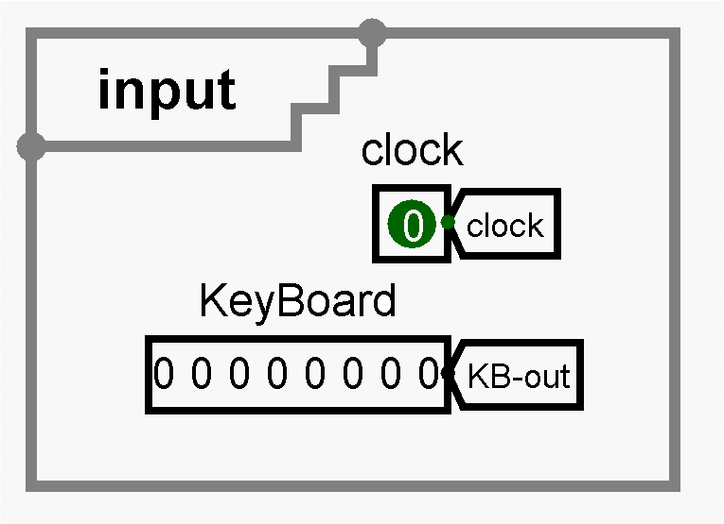
State manager
CDM8+.circuit

Slide 13
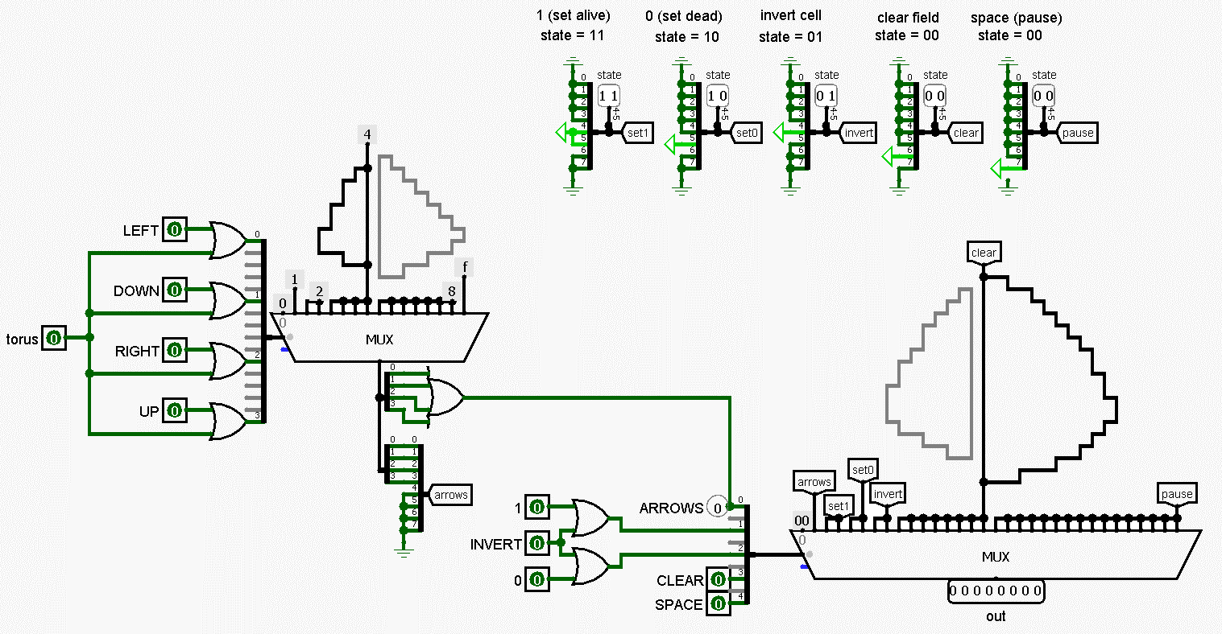
Keyboard
keyboard.circuit

Slide 14
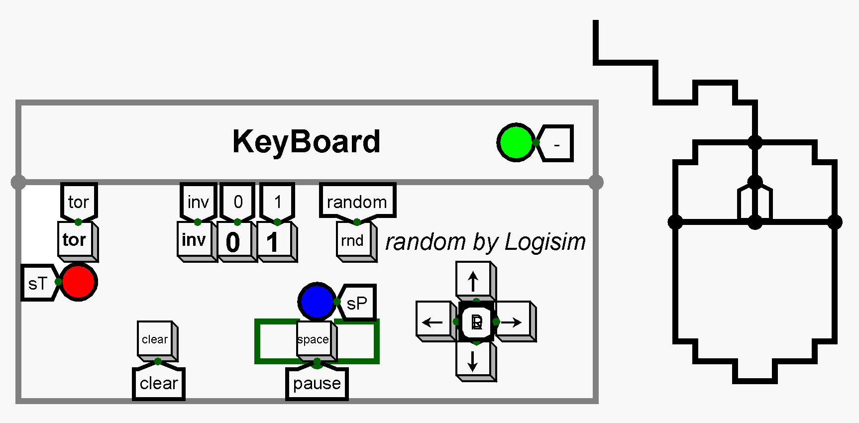
Keyboard
main.circuit

Slide 15
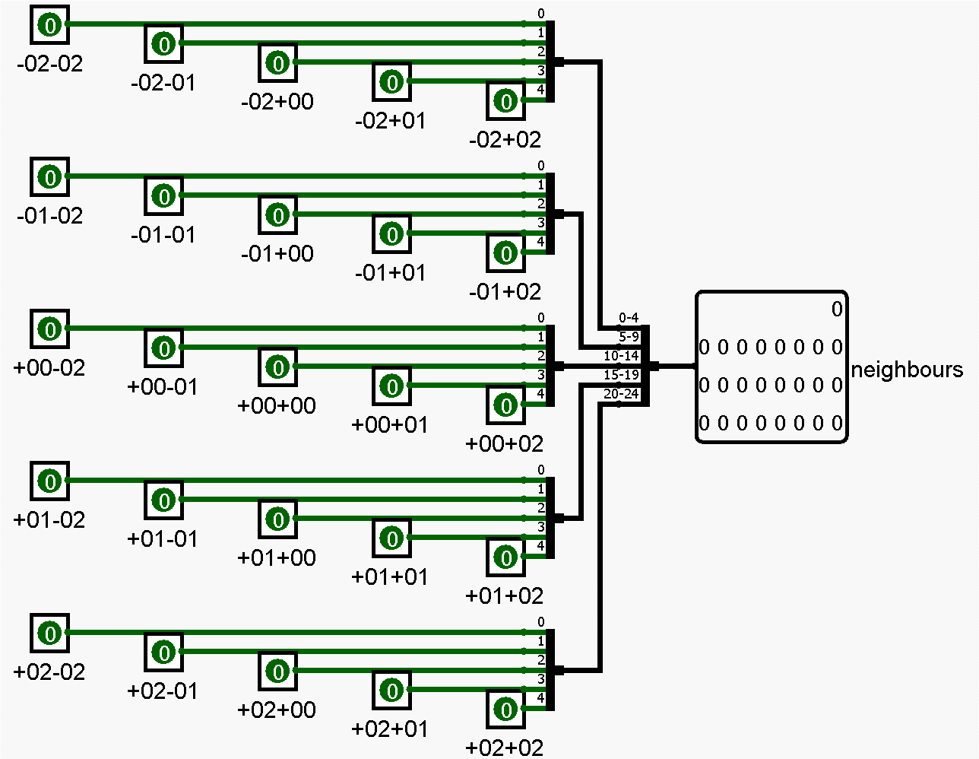
Neighbours
neighbours.circuit

Slide 16
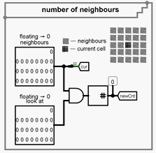
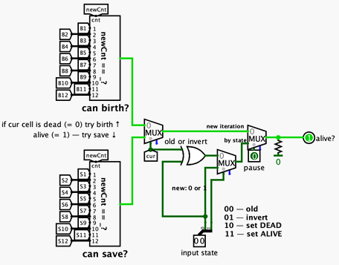
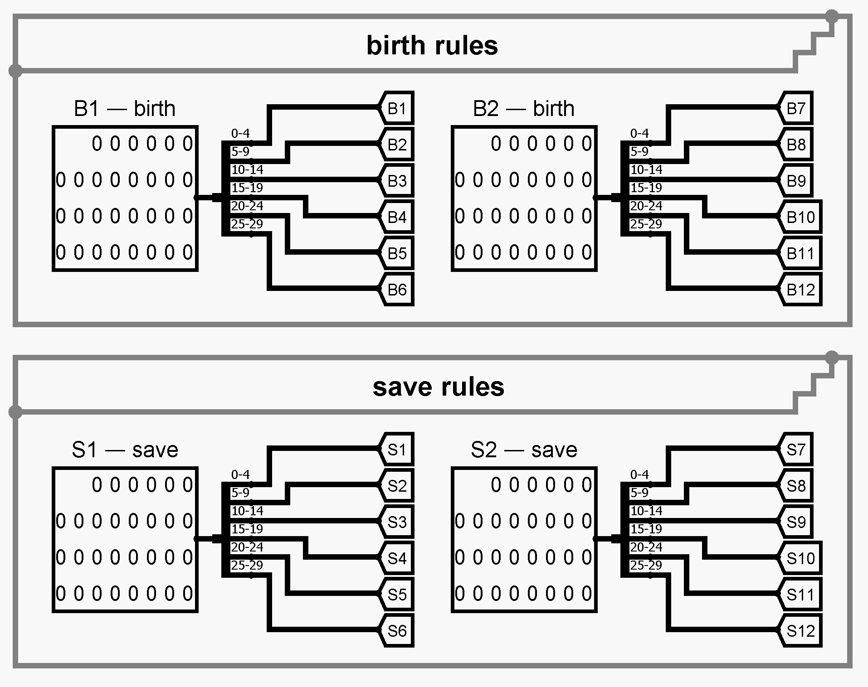
Alive
alive.circuit

Slide 17
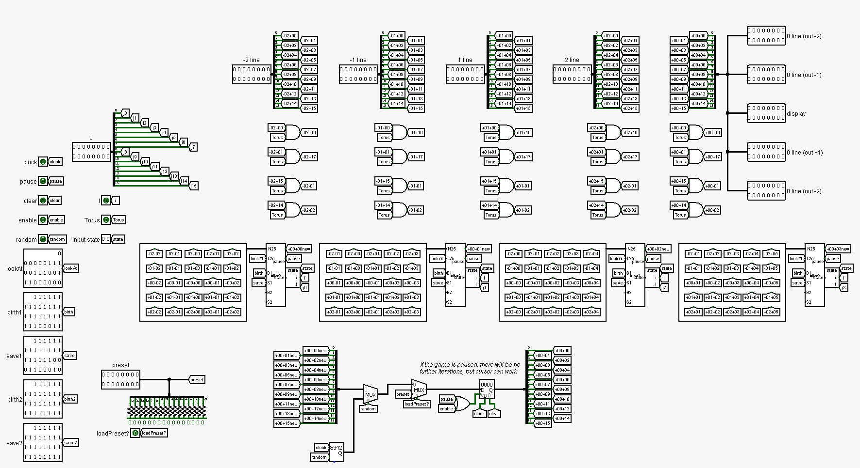
Line
line.circuit

Slide 18
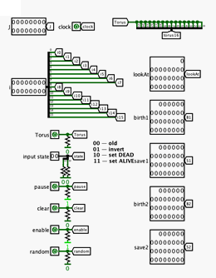
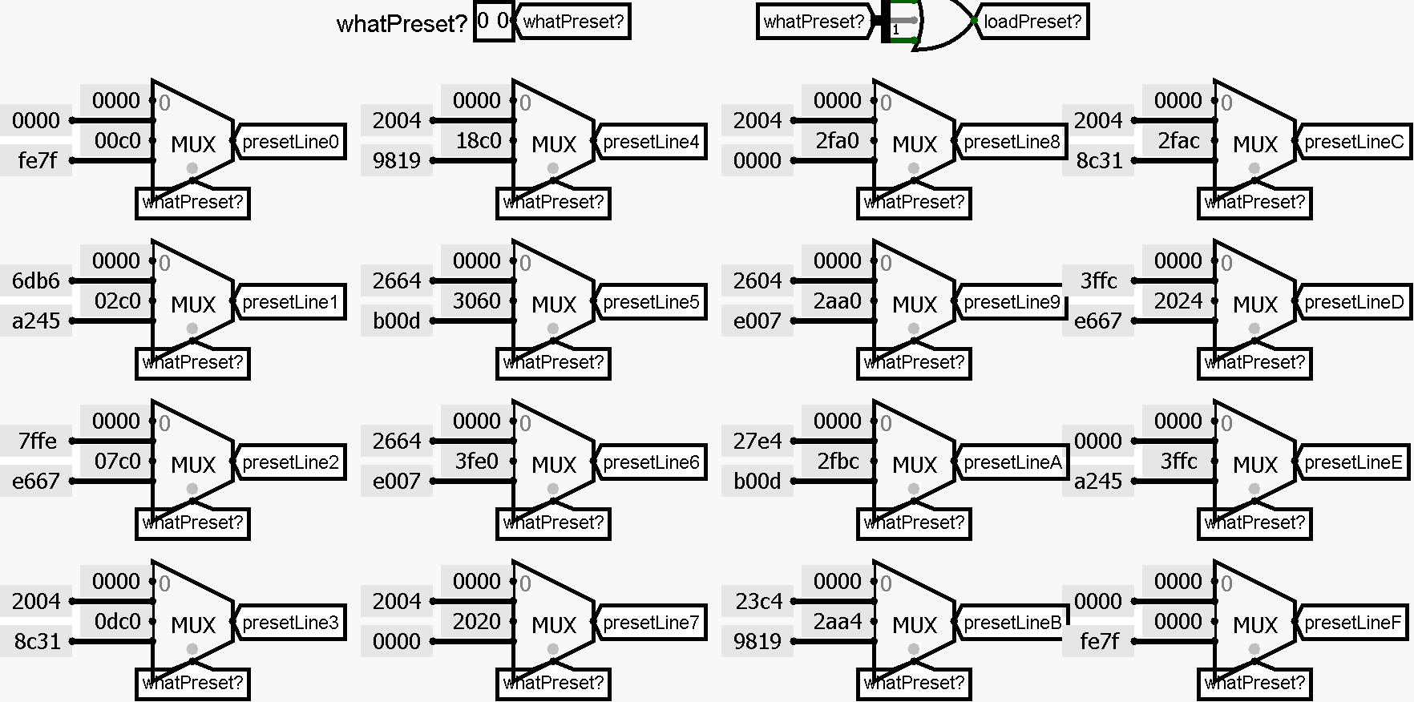
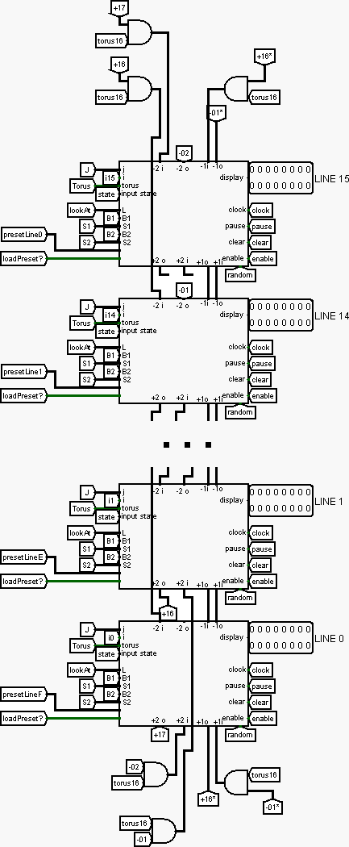



Matrix
input
presets
16 lines
matrix.circuit

Slide 19
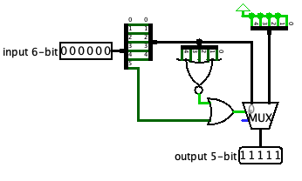
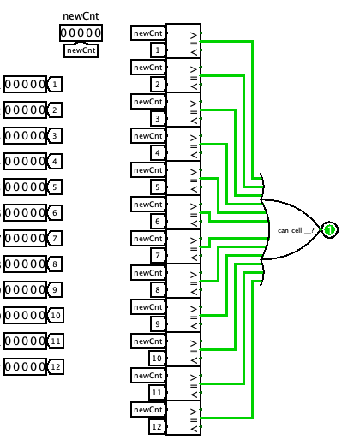
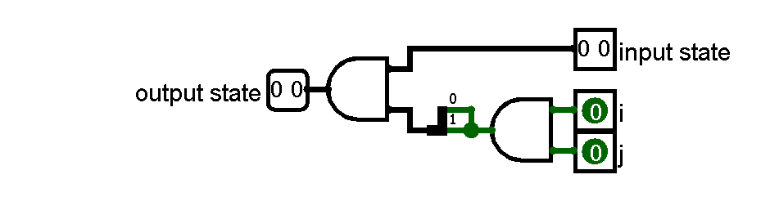
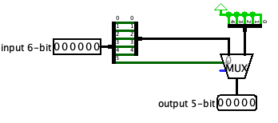
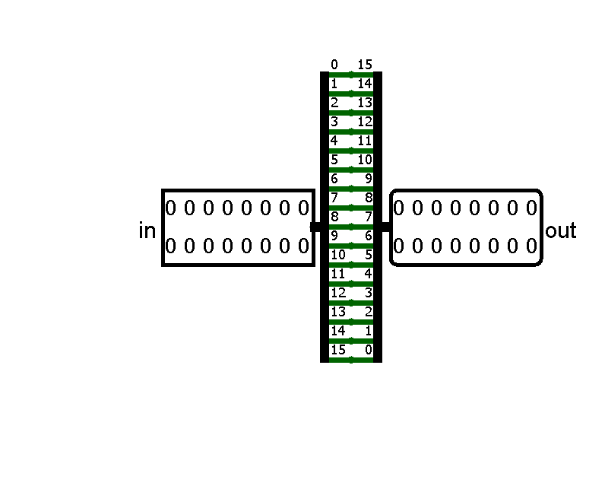
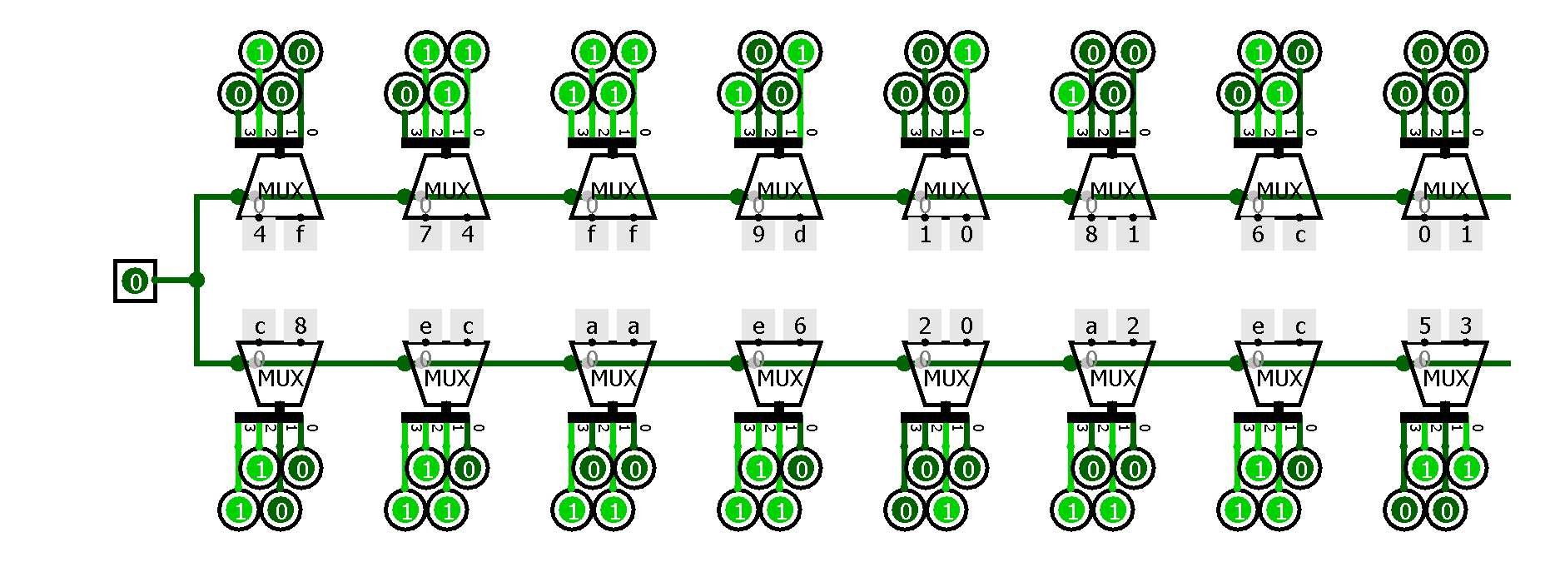
Help Schemes
BS-helper (0 –>31)
STATE-helper
BS-helper
OR12
reverse16Bits
text

Slide 20
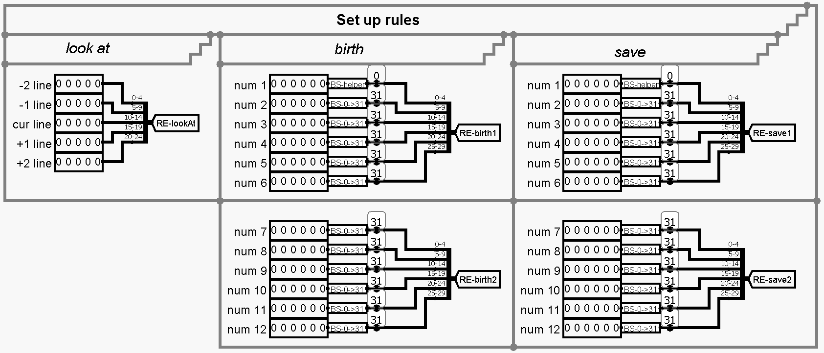
Changes
Rules editor

Slide 21
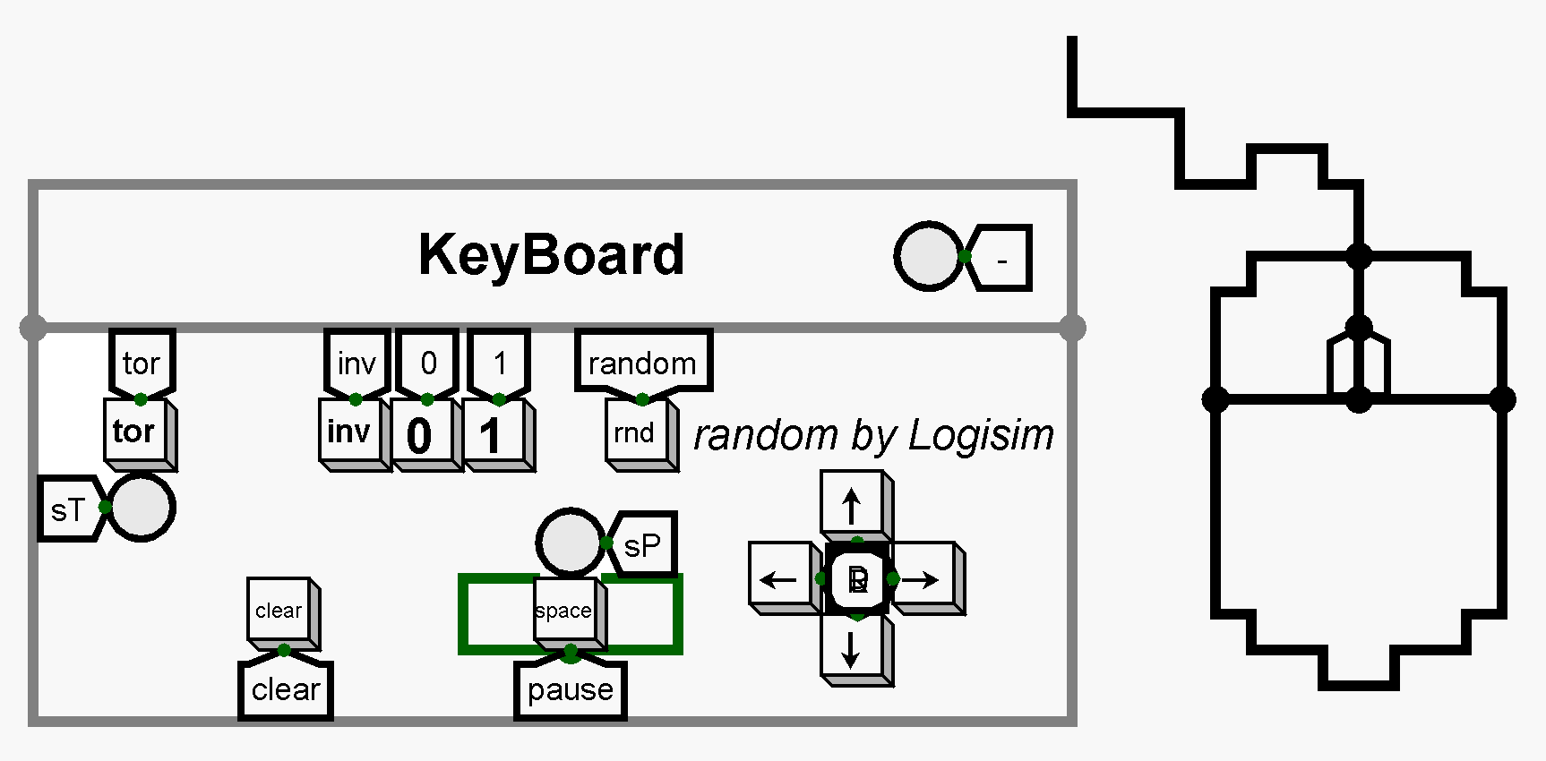
Improvements
Keyboard
Toroidal cycled field (torus)

Slide 22
{04}
Software

Slide 23
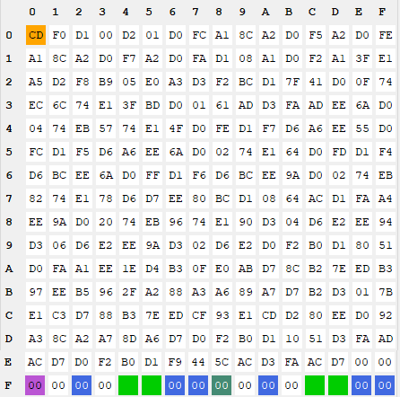
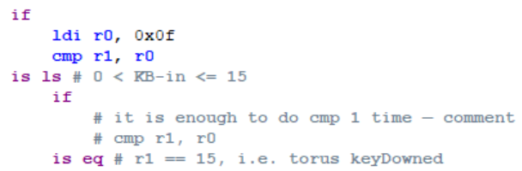
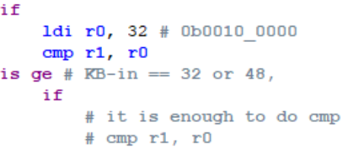
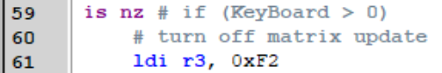
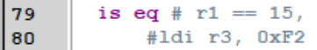
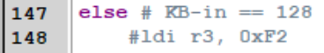

Slide 24
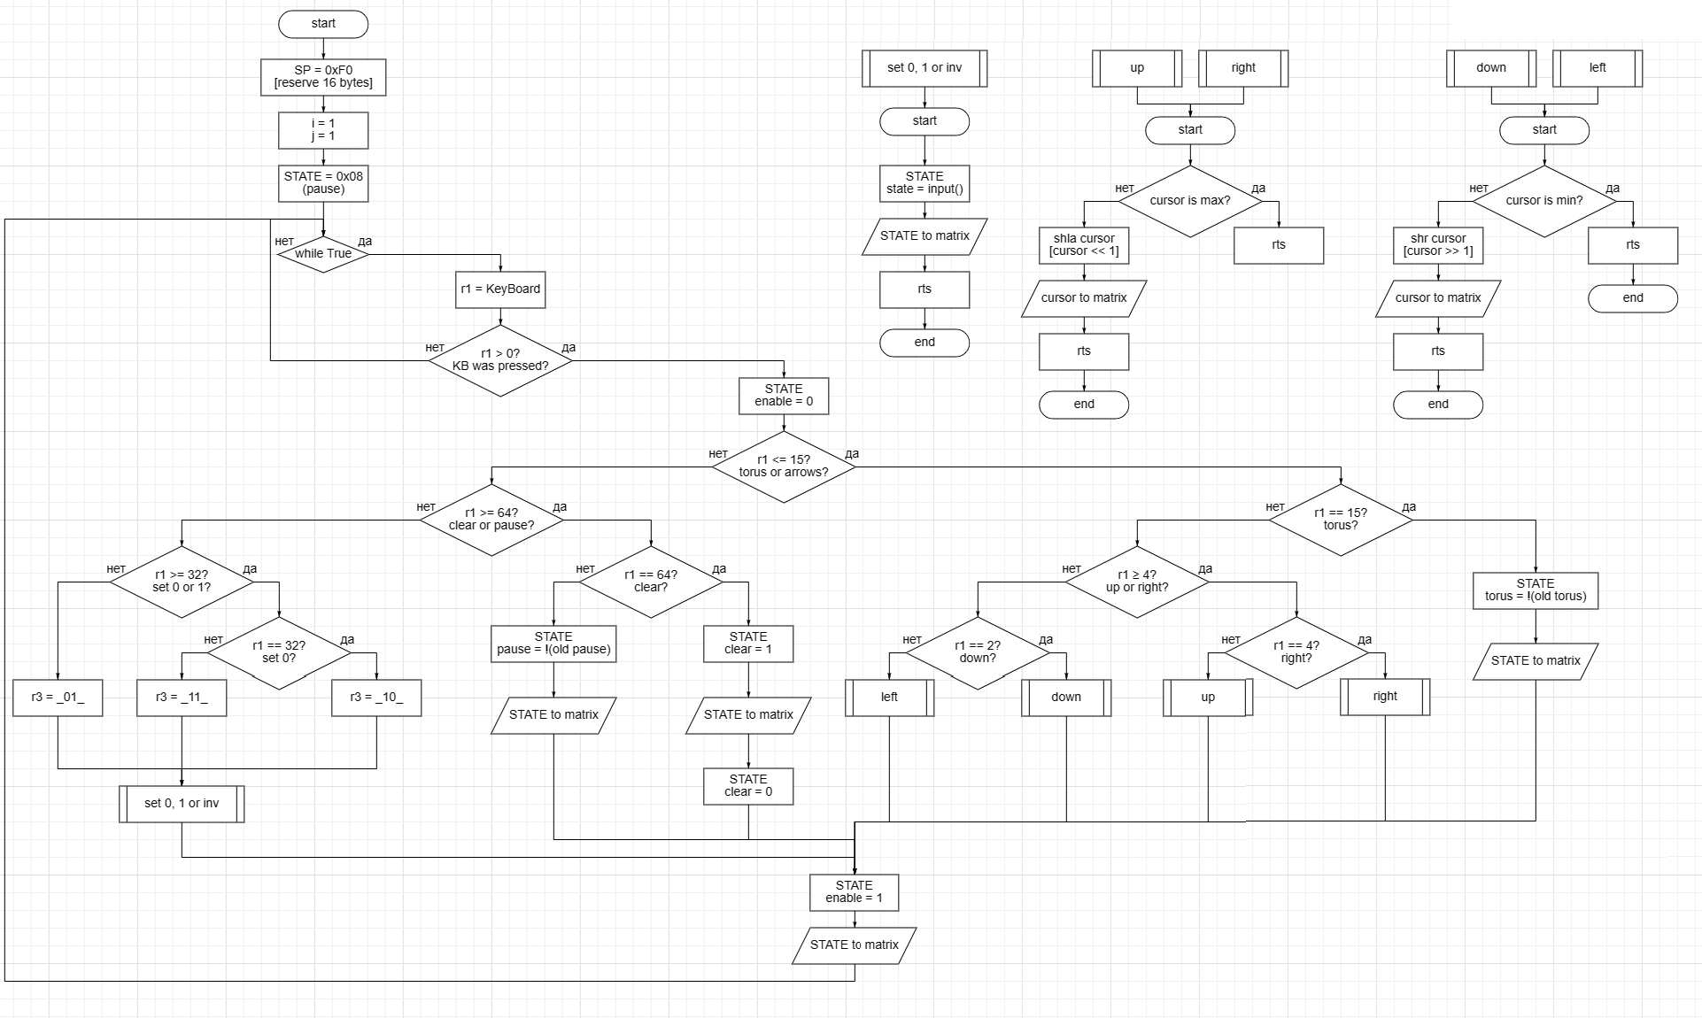

Slide 25
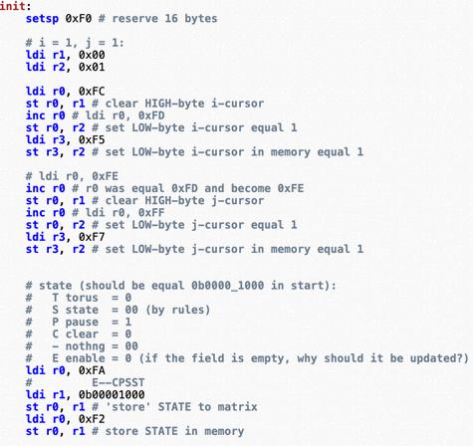
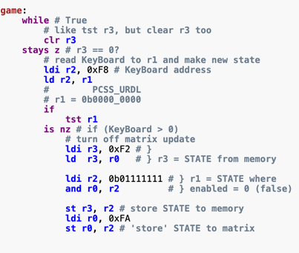
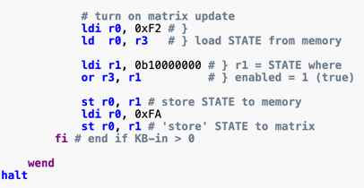

Slide 26
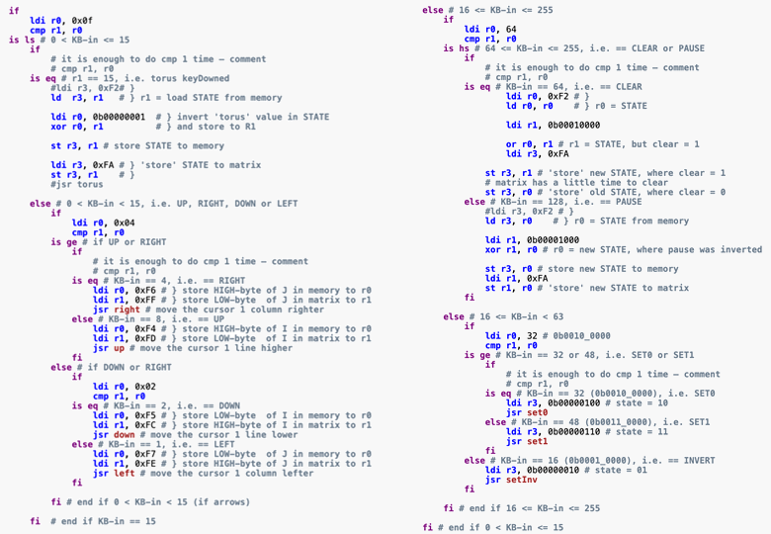

Slide 27
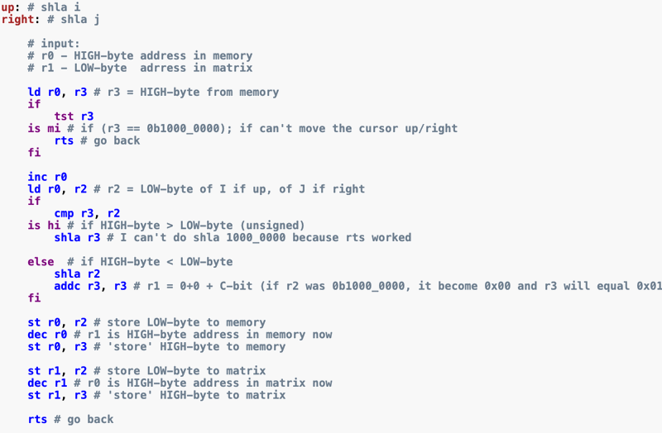

Slide 28
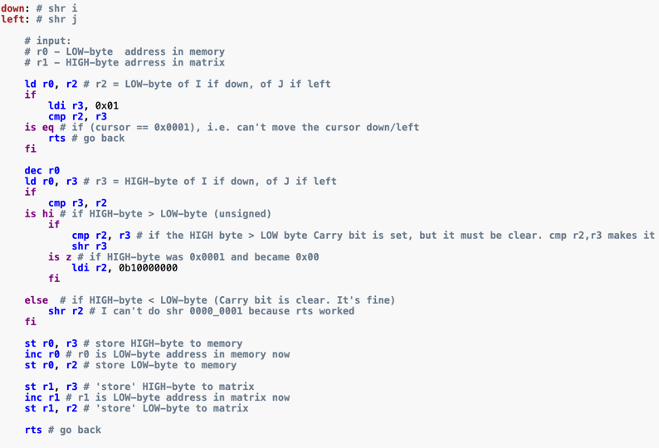


Slide 29
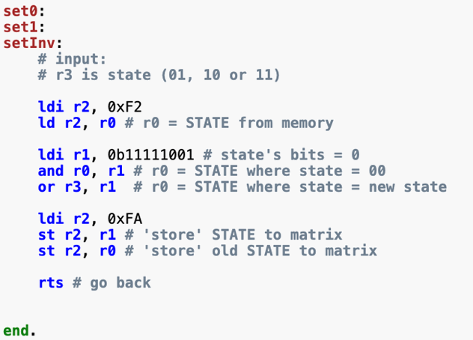

Slide 30

Conclusion

Slide 31

Thanks
Martynov B & Belov D , 23217

